Slide 1
Statistical Analysis of Attrition & Salary at Frito-Lay
Willis A. Jones
wajones@smu.edu

Slide 2
Presentation Outline
Employee Attrition
Employee Salary
Notes:
There are two things I want to do during this presentation (as the title of the presentation would suggest) First I will talk about my analysis of employee attrition at your company. Second I will talk about my analysis of employee salaries.

Slide 3
Question 1
What variables are most strongly associated with employee attrition at Frito-Lay?

Slide 4
Data Used
Dataset consisted of 870 employees with 38 variables.
Software used for analysis: R & RStudio
Notes:
I answered that questions using the dataset you all provided on 870 employees. For each employee there were 38 variables made available to me.
I used R and R studio to answer you question presented and I feel that, using several data science tools, we were able to extract interesting insights from this data…..

Slide 5
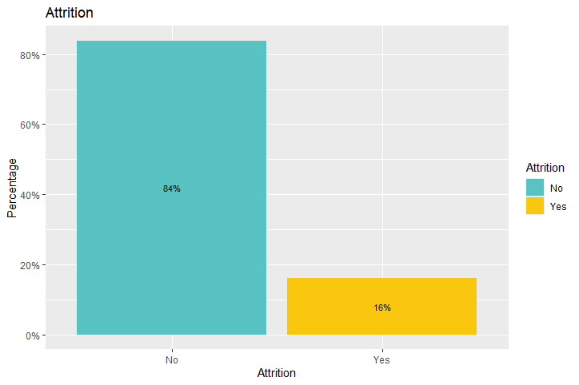
Notes:
First, lets look at overall attrition…about 16% of employees in this dataset left the company. According to some research I found, the average attrition rates for large companies is around 11%. So frito-ley seems to be a bit higher than the norm.

Slide 6
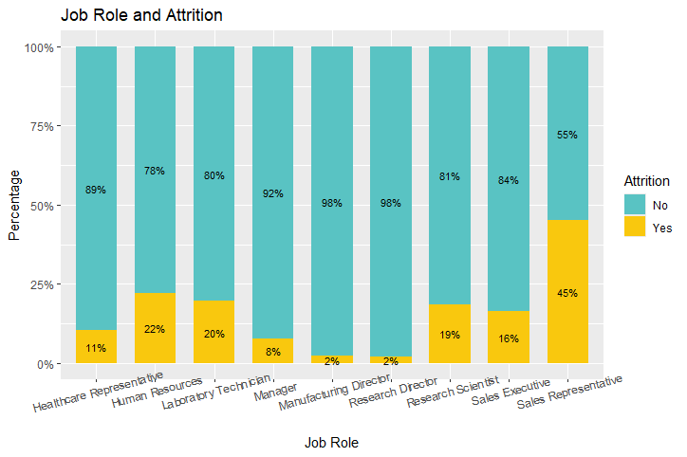
Notes:
You all asked specifically about attrition by job role. Here is a visualization of that relationship. As you can see, attrition is a big problem within sales were 45% of employees leave. Other areas with high levels of attrition are human resources, Lab technicians, and in the research department with directors and scientist.

Slide 7
Data Analysis Process
Estimated the correlation between attrition and each employee variable in the dataset
Ranked the absolute value of correlation coefficients
Starting with the variables with the highest correlation with attrition, I added variables to a Naïve Bayes classifier with the goal of building a model with high sensitivity (>.60) and specificity (>.60)
Notes:
To conduct my analysis, I took the following steps….first I

Slide 8
Data Analysis Process
I used K-Fold (10 folds, 50 repetitions) Cross Validation to evaluate the predictive power of my Naïve Bayes model
Notes:
Finally, I used

Slide 9
Variables with strongest correlation with attrition
Overtime (.27) Working overtime was correlated with higher levels of attrition
Marital Status (.19) Being single correlated with higher levels of attrition
Job Involvement (-.18) Higher levels of job involvement correlated with lower levels of attrition
Notes:
There were 3 variables with the strongest correlation with attrition. First, was overtime……
Divorced and married individuals were less likely to leave the company.
Just adding these three variables into a machine learning algorithm did not produce a high amount of predictive power….so to build a better classifier I needed to add move variable to my model.

Slide 10
Variables included in the Naïve Bayes algorithm
Variable Name | Correlation with Attrition
JobInvolvement | -0.1877934
TotalWorkingYears | -0.1672061
JobLevel | -0.1621364
YearsInCurrentRole | -0.1562157
MonthlyIncome | -0.1549150
Age | -0.1493836
StockOptionLevel | -0.1486803
YearsWithCurrManager | -0.1467822
YearsAtCompany | -0.1287541
JobSatisfaction | -0.1075209
Variable Name | Correlation with Attrition
OverTime | 0.2720366
MaritalStatus | 0.1970150
JobRole | 0.0905386
DistanceFromHome | 0.0871363
Department | 0.0870320
Notes:
These were the variables I added to the model. I essentially took the 15 variables with the highest correlation with Attrition and added them to the classification model.

Slide 11
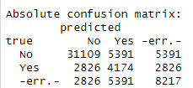
Results of Cross Validation
True positive rate (Sensitivity) = .85
True negative rate (Specificity) = .60
Notes:
The results of the cross validation are presented here with a confusion matrix…..Our model did a really good job of predicting those who did not leave the company…it was a little less successful in identifying those who did leave the company.
Overall, however, this classifier did a pretty good job of predicting who is at risk of leaving the company.

Slide 12
Action Items
Consider limiting overtime of workers.
Carefully monitor single employees and consider resources that can increase their retention.
Look for ways to increase the involvement of all employees as a retention strategy.
Pay specific attention to individuals in sales and research/development when looking for ways to increase retention.
Notes:
Based on this first analysis, here are a few action items to consider….

Slide 13
Question 2
What variables are most strongly associated with employee salaries at Frito-Lay?
Notes:
We can start with the first question you all asked me to look at. That question was what variables are most strongly associated with employee attrition at FritoLey

Slide 14
Data Analysis Process
Used same data as in previous analysis
Estimated a linear regression model with all covariates, then ran forward coefficient selection using AIC criteria
From this forward selection, 10 variables were selected for the full model
Notes:
To conduct my analysis, I took the following steps….first I

Slide 15
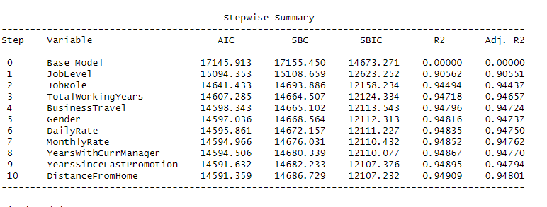
Notes:
To conduct my analysis, I took the following steps….first I

Slide 16
Cross Validation
Holdout (80/20 split) cross validation produced an RMSE of 971.74
Notes:
To conduct my analysis, I took the following steps….first I

Slide 17
Conclusion
Two variables are able to explain most (almost 94%) of the variation in income among employees.
Those with higher job level and those in Management and Research Director roles earned the most money.
Notes:
Whatever value you get from a person working overtime might be offset by the cost of having to replace that person down the line.
When people feel invested in a company, they want to stay at that company

Slide 18
Thank You!
For additional information
Willis A. Jones
wajones@smu.edu
Notes:
Thank you very much.
If you would like further analysis of these data, we can certainly follow up with you.
Here is our contact information.
And we are happy to take any questions that you may have.

